Slide 1
SMART Home
Group 2:
John Satterla – Computer Engineer – Wireless Connectivity
Zachary Eakerns – Electrical Engineer – Biomedical Station
Zarka McClung [Team Lead] – Computer Engineer – Facial Recognition
Christian Jensen – Electrical Engineer – Voice Recognition

Slide 2

Last Week's Deliverables
John Satterla
Zachary Eakerns
Zarka McClung
Christian Jensen
Test ToF further with optimizations
Send meaningful data over Zigbee network for logging of health data
Start developing GUI for system monitoring and control
Have Python
communication with MCU ready for testing
Hardware research
Select method to open door
Order some parts to begin testing
Continue work on Recognition software
Start green board design

Slide 3



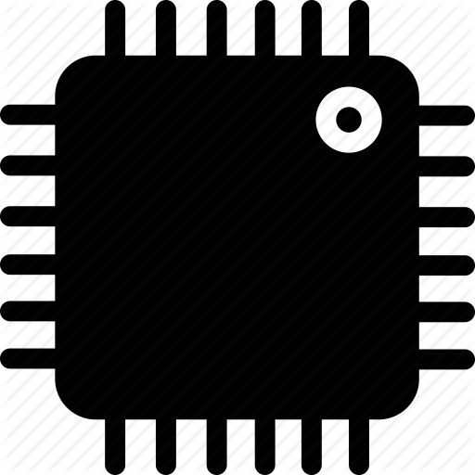






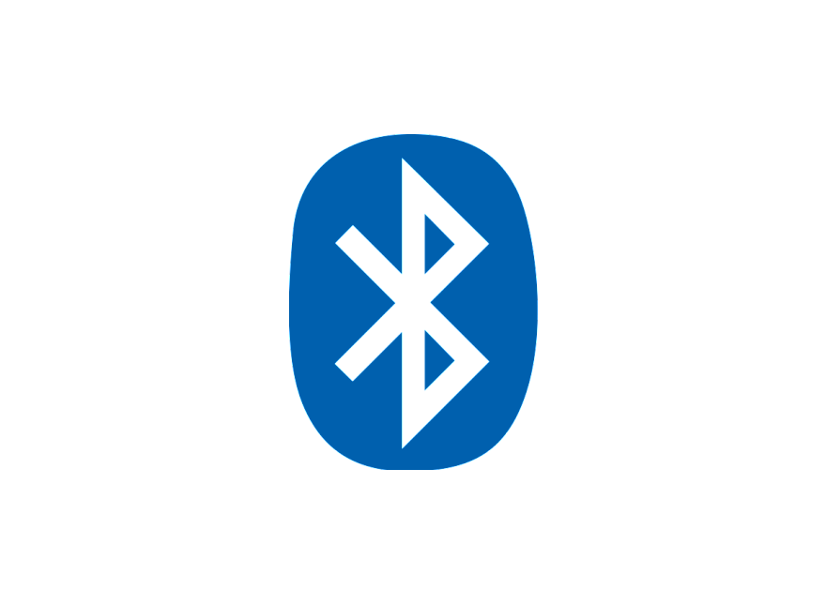


System Overview
Door can be opened automatically via facial recognition or control from central processing station via Zigbee
LEDs to represent Lights
LCD screen represents TV
Biomedical station gets EKG, heart rate, and blood oxygenation of the user, relays information to the Central processing station. Zigbee module takes commands from central processing station to control devices
Biomedical Station
Full size automatic door with facial recognition
Servo based washer representation
Small Scale House Model
Computer fan to represent ceiling fan
Portable BLE Time of Flight device reacts to movements of user throughout the room and devices turn on inside the small scale model
Portable Location Detection Device
Central processing station (computer) displays system information and can control devices via voice commands. Communicates with rest of devices via Zigbee
Bluetooth ToF Beacon
Zigbee Module
Central processing Station, with Voice Recognition
Microcontroller
John Satterla

Slide 4
Tracking Location of the Patient Monitor
Ideally work indoors, so using GPS not preferred because of accuracy and not able to get fix inside of buildings
BLE ToF – Bluetooth Time of Flight
Time of Flight is used to estimate range by measuring the round trip delay of an RF packet exchange
At least two devices needed, and operate generally as a master and a slave, where the master calculates average round trip delay for hundreds of packets to be as accurate as possible (try to reduce error from interference, other RF related differences) [4]
John Satterla

Slide 5
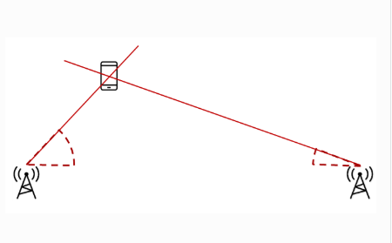
Tracking Location of the Patient Monitor
For this, Texas Instruments has a experiential stack that I am going to evaluate and see what kind of performance I can get
The tricky part will be using two masters that are positioned at two known points, and then connecting to the single slave on the patient to triangulate it’s position
Patient monitor
Master 2
Master 1
[3]
John Satterla

Slide 6
BLE ToF – Further Testing
Testing was done to see if interference was cause of problem with location returning negative values
Testing was to no success after testing in environment with limited 2.4GHz interference, although it did seem better than basement lab
In contact with TI on how to improve performance, was directed to some optimization tools in the software that will be tested this week
John Satterla

Slide 7
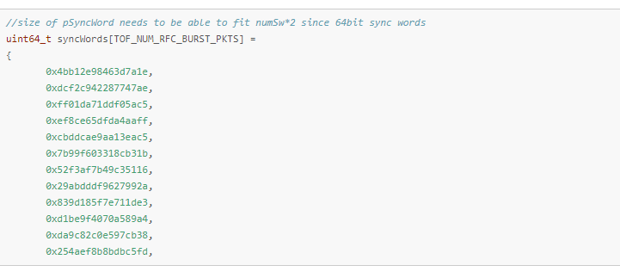
BLE ToF – Further Testing
[2]
Going to try and increase the number of syncwords, which serve as almost ‘ACKs’ that sync each ToF flight packet with each other
John Satterla

Slide 8
Graphical User Interface - Vision
Relatively simple design, ability to monitor and manually control the connected devices
LED 1
Fan
LED 2
Washer
LED 3
Door
LED 4
TV
BioMedical Data

Slide 9
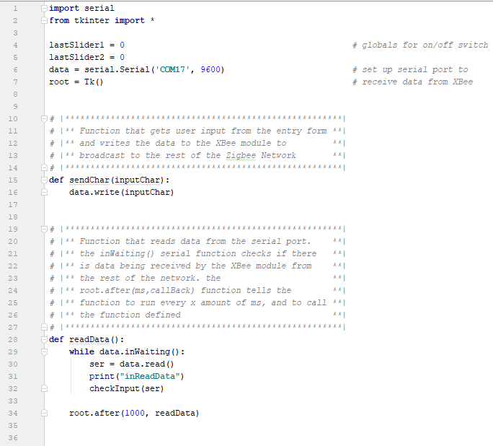
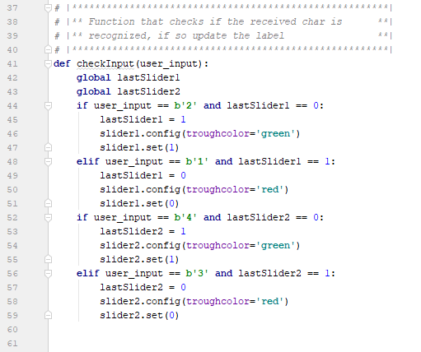
Graphical User Interface – Early Development
Using Python 3, with tkinter as GUI, and pyserial for communication to USB dongle with Xbee module

Slide 10
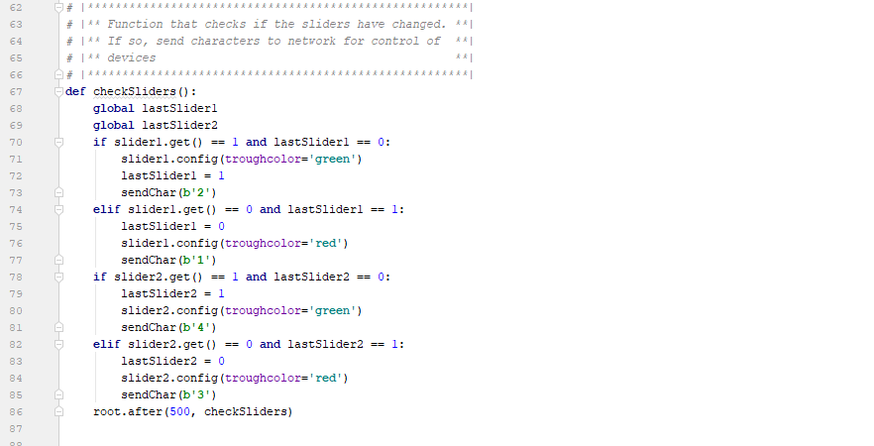
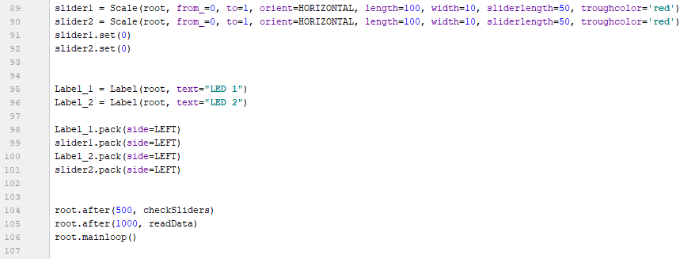
Graphical User Interface – Early Development
Using python 3, with tkinter as GUI, and pyserial for communication to USB dongle with Xbee module

Slide 11
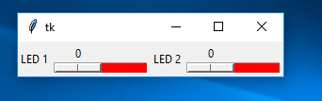
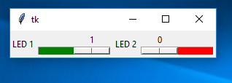
Graphical User Interface – Early Development Results
Using python 3, with tkinter as GUI, and pyserial for communication to USB dongle with XBee module
Simple for now, takes sliders and can send commands across Zigbee network
Can also update the button or device’s status with commands from network
Lots of lines for 2 buttons (>100), but serial integration and ability to monitor network is much easier in python
Python will be easier to deal with medical data

Slide 12
Graphical User Interface – Video Demo
Using python 3, with tkinter as GUI, and pyserial for communication to USB dongle with Xbee module
Simple for now, takes sliders and can send commands across Zigbee network
Can also update the button or device’s status with commands from network
Video: GUI on laptop computer, MSP430 Launchpad receiving power from USB hub with XBee conncected to Zigbee network for communication
Sending information to GUI
Sending commands from GUI

Slide 13
Changing Software
Using Code Composer Studio in conjunction with launchpad is far too slow to accurately graph data every 2 ms for EKG readings
To fix this, research into using Python along with UART communication via BlueSMiRF is underway
Microcontroller will still be coded in Code Composer Studio, however receiving data and graphing it will be done through Python

Slide 14
Python
Data can be graphed quickly in Python by using the matplotlib library
Python will store the data received by the BlueSMiRF [2] into a vector and then graph the value
Things to be mindful of include making sure baud rate of both the communication method and the microcontroller are matching, and that vector can delete past values in case the machine is left on for a long amount of time

Slide 15
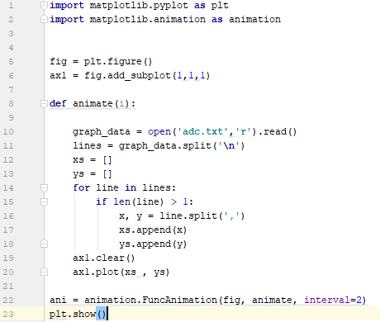

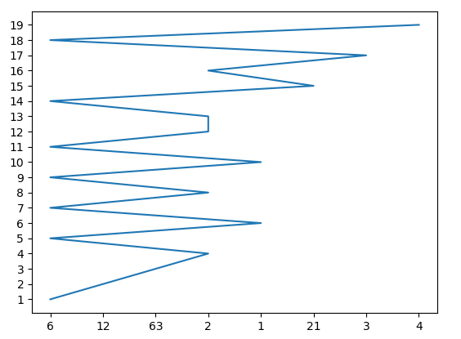
Matplotlib

Slide 16
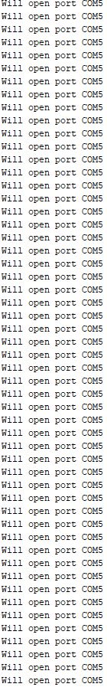
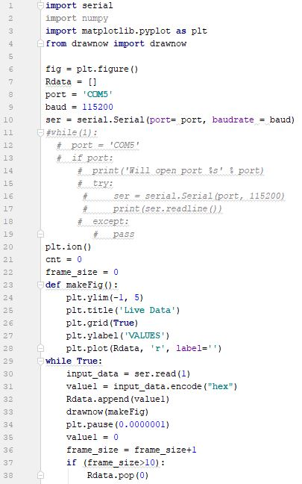
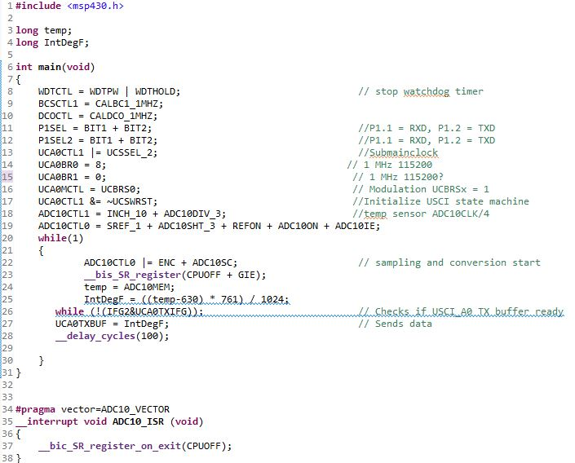
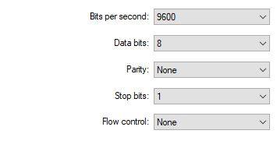


Slide 17
Instability In Circuitry
While amplification circuit seems to work, as well as the filters removing transmission line noise, the output is unstable at lower frequencies, varying by as much as 20%
Could be due to breadboard, faulty parts, or faulty measuring equipment
Further work will go into identifying issue once code catches up since switching to Python created a setback

Slide 18
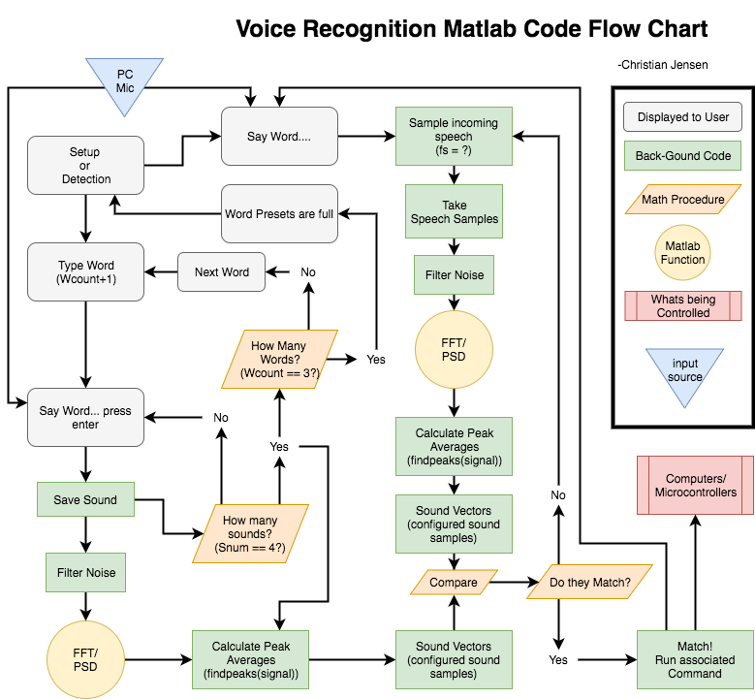

Slide 19
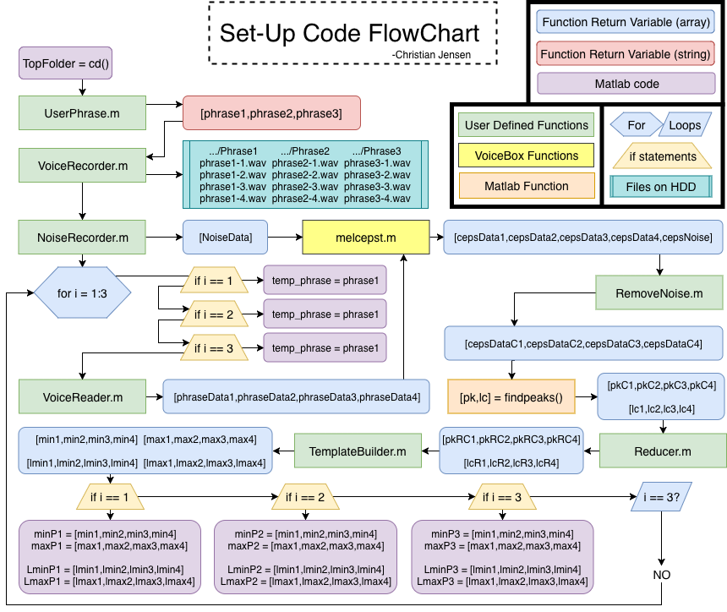

Slide 20
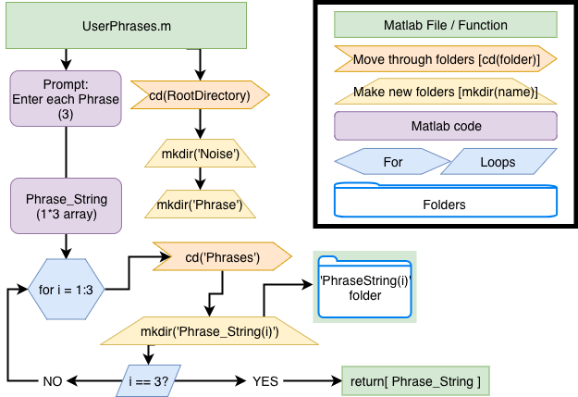

Slide 21
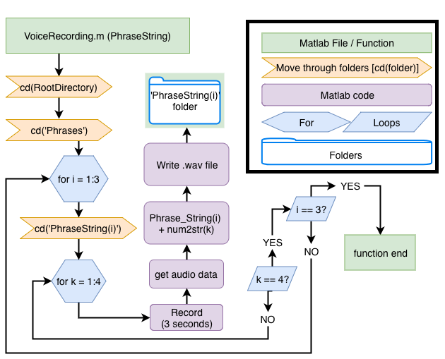

Slide 22
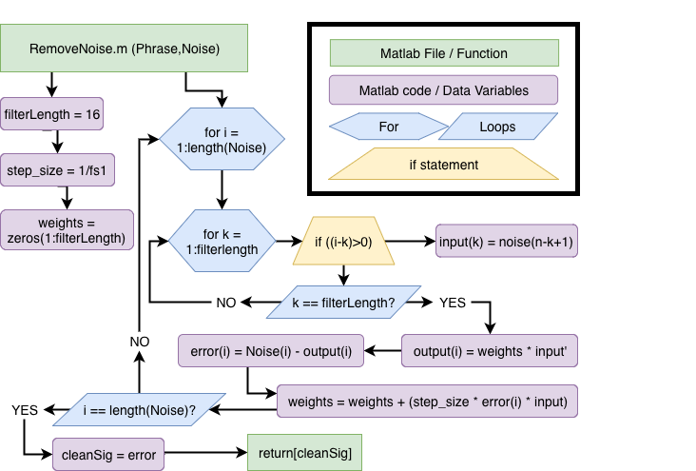
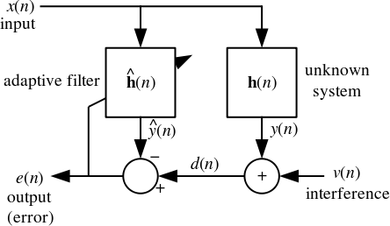
Least Mean Squared adaptive filter

Slide 23
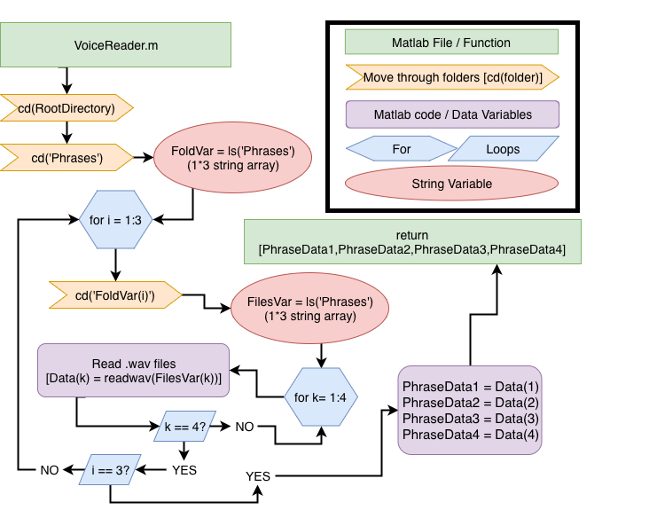

Slide 24
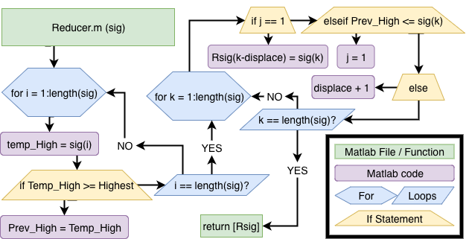
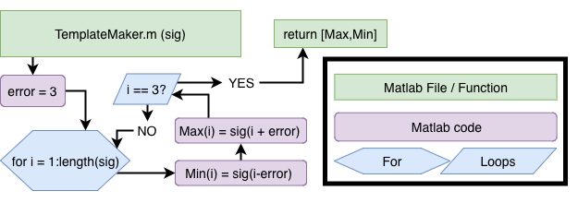

Slide 25
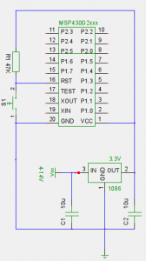
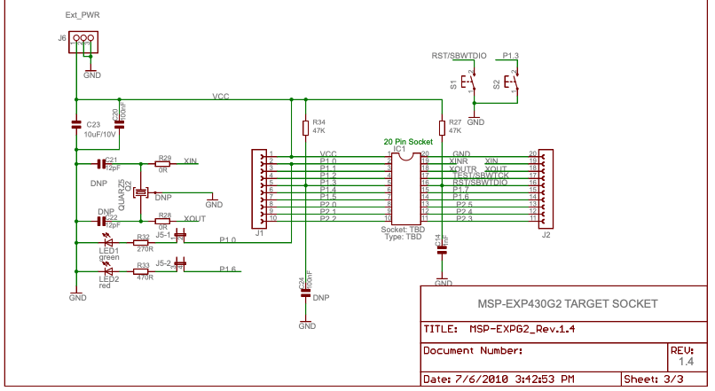
MSP off the LaunchPad
Requires a couple of extra components to function
47kohm FB resistor [3]
10µF Caps off the regulator[3

Slide 26
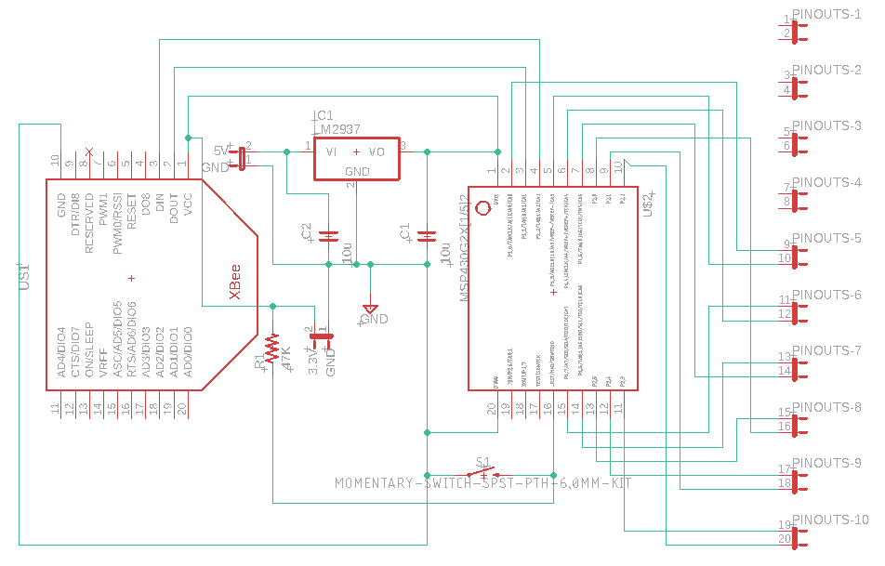
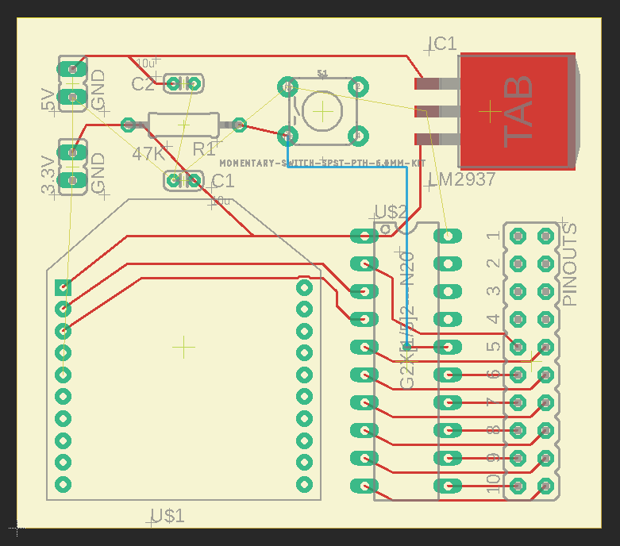
Green Board Design
MSP paired with an XBee Module
MSP430G IC
XBee Module on header pins
Design done in Eagle Cad
3.3V LM2937 regulator located on board
Not final choice for regulator, just a place holder*
GND plane still needs to be added

Slide 27
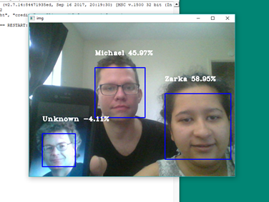
Face Recognition
Completed Face Recognition software to detect user successfully. Will be tweaking it more down the road after main goal to open the door is completed.
Using around 20 dataset sample: 58%
Used around 200 dataset sample: 60-65%

Slide 28
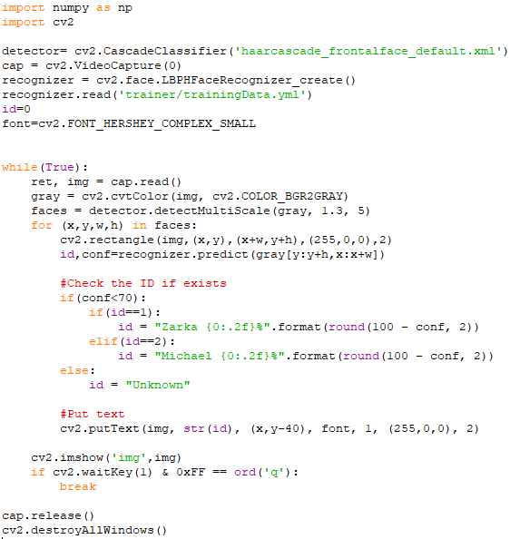
Face Recognition
Conf is how much difference it has to match collected dataset.
"0" is a perfect match

Slide 29
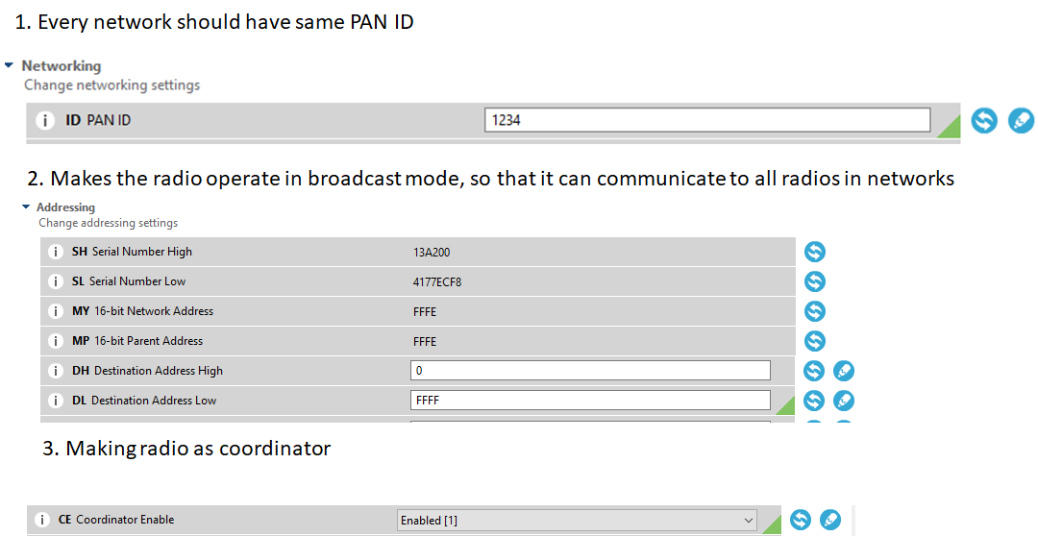
Radio 1 (master) configurationCOM9

Slide 30
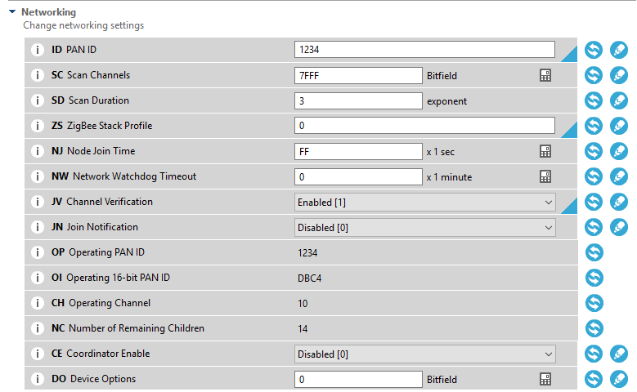
Radio 2 (slave) configuration COM8
Everything will be same, except it will act like a router instead of main co-ordinator.

Slide 31
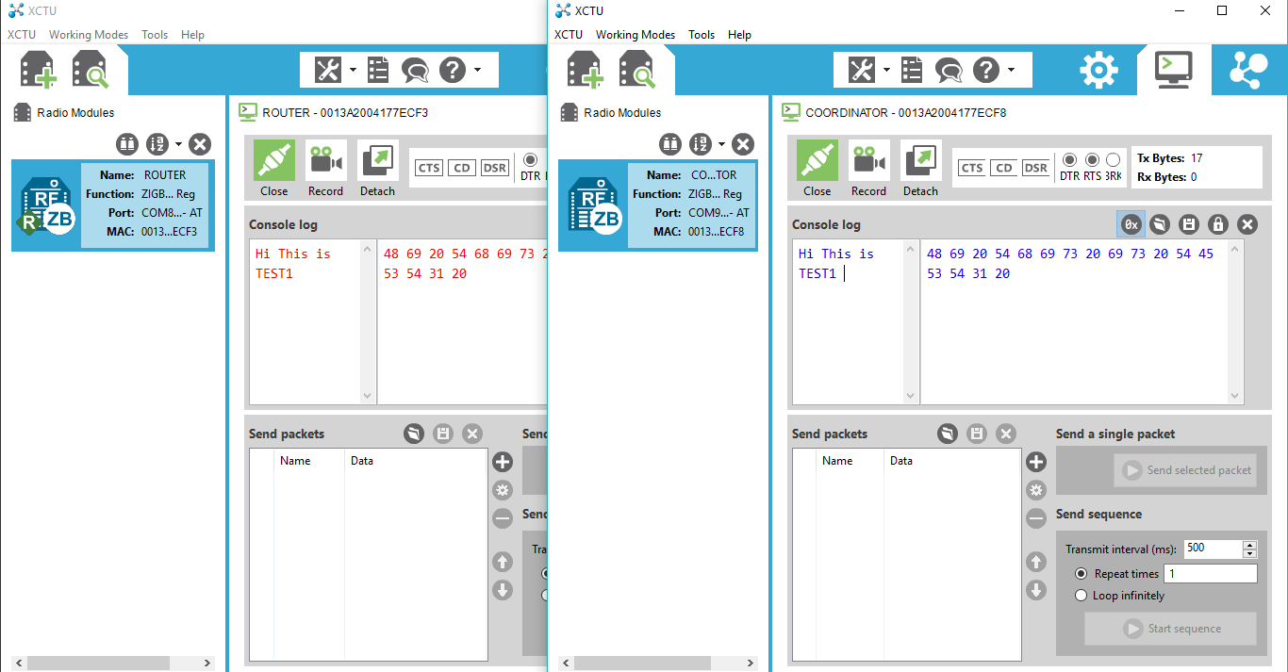
Bi-directional Communication- Mesh Network
Transmitted message in Blue
Received message in Red

Slide 32
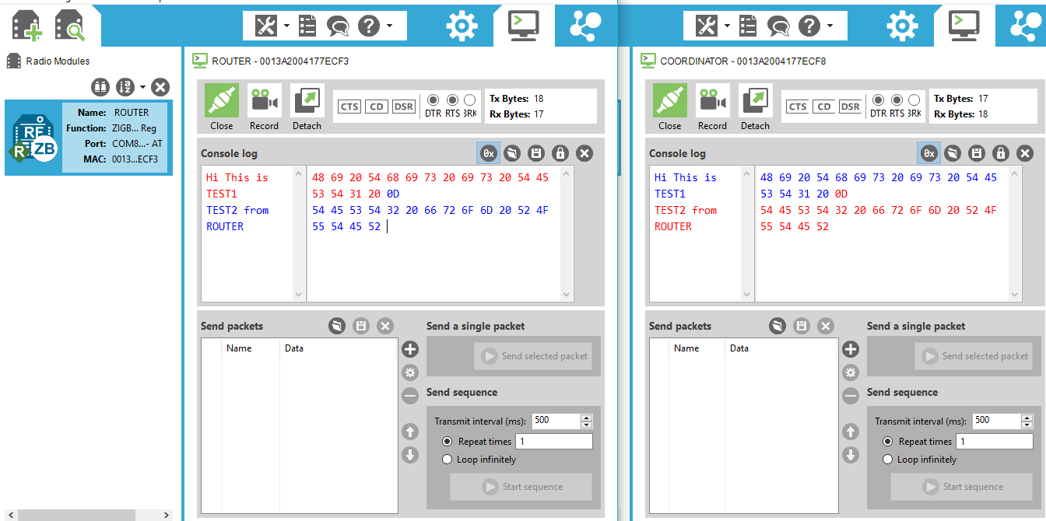
Bi-directional Communication – Mesh Network
Transmitted message in Blue
Received message in Red

Slide 33
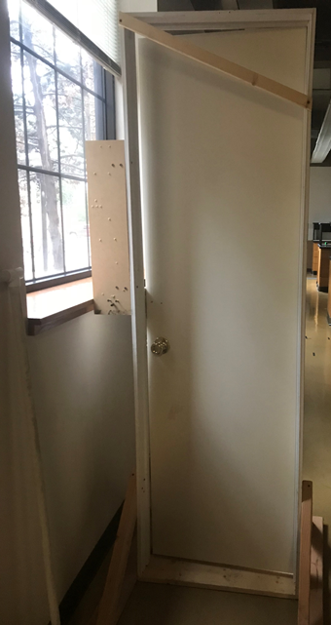
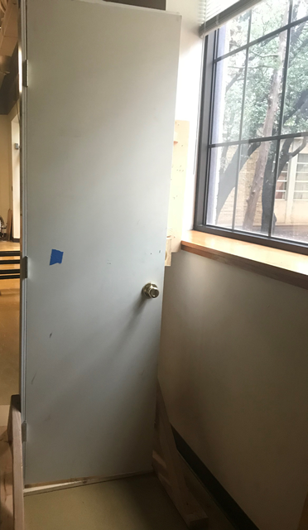
Opening door concept
Motor on one side with a string attached to a nail
Stepper Motor

Slide 34
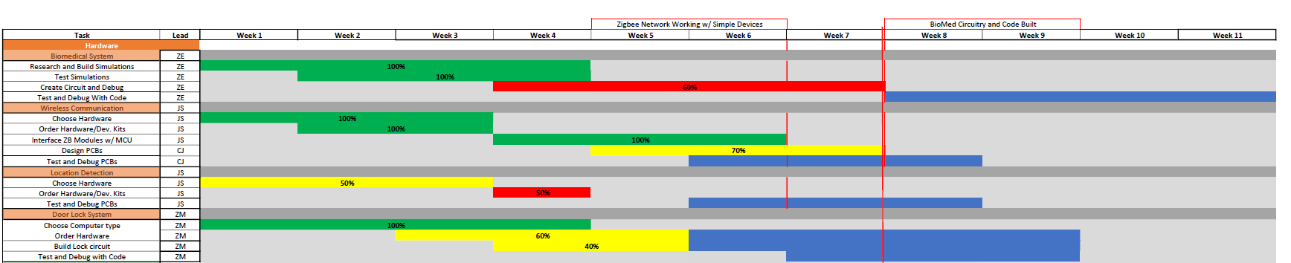
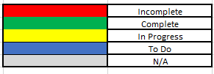
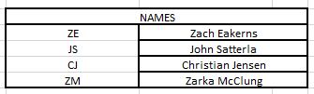
Gantt Chart

Slide 35
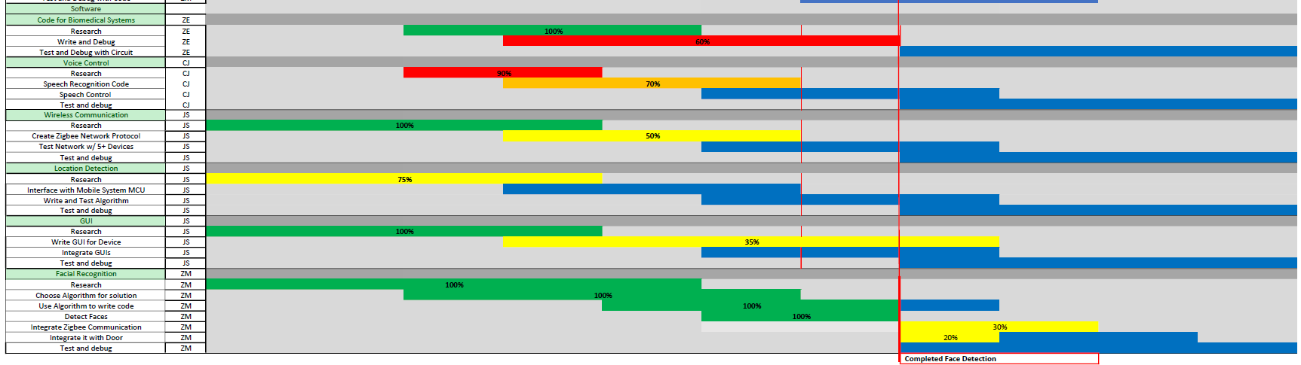
Gantt Chart

Slide 36
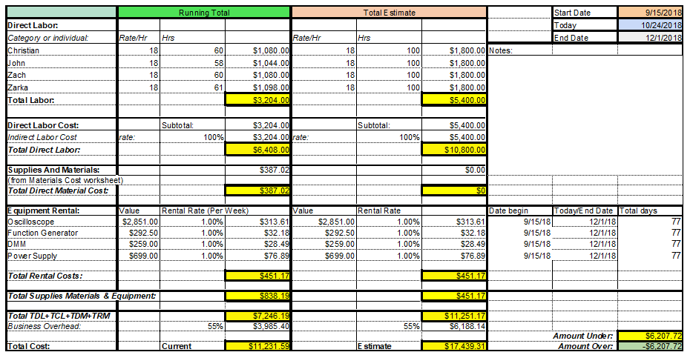
Budget

Slide 37
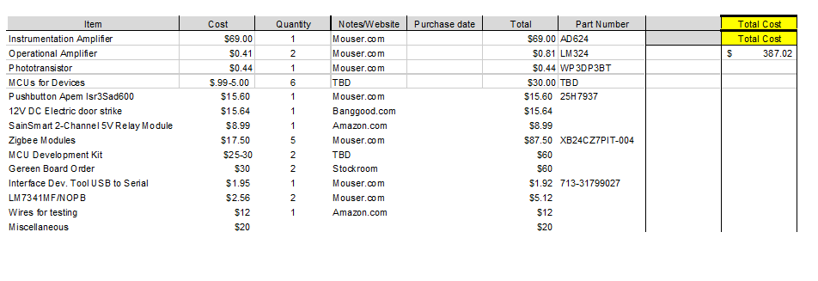
Material Cost

Slide 38
Next Week's Deliverables
John Satterla
Zachary Eakerns
Zarka McClung
Christian Jensen
Have working location tracking
Determine all Zigbee protocol commands
Begin integrating and building out GUI
Have python graphing the ADC in real time
Make headway on circuit instability
Write Python code to send serial communication to Zigbee
Establish motor code upon signal from Zigbee co-ordinator
Finish green board design
Continue writing Matlab code for voice recognition

Slide 39
References
“MSP-EXP430G2 LaunchPad™ Development Kit.” SLAU318G, Jul-2010.
“RN-42 Data Sheet.” [Online]. Available: https://cdn.sparkfun.com/datasheets/Wireless/Bluetooth/Bluetooth-RN-42-DS.pdf. [Accessed: 23-Oct-2018].
S. Wendler, “MSP430G2xxx Stand Alone,” kaltpostde RSS. [Online]. Available: http://www.kaltpost.de/?page_id=1079. [Accessed: 31-Oct-2018].
“Time Of Flight (TOF) Initiator,” TI Cloud Tools, 2018. [Online]. Available: http://dev.ti.com/tirex/#/?link=Software/SimpleLink CC2640R2 SDK/Examples/Development Tools/CC2640R2 LaunchPad/blestack/tof_initiator. [Accessed: 24-Oct-2018].

Slide 40
Questions?

